Slide 1
SRM Institute of Science and Technology Advanced Programming Practice-18CSC207J Unit 3 - PARALLEL & CONCURRENT PROGRAMMING PARADIGM

Slide 2
TOPICS – Parallel programming
Multi-threading, Multi-processing
Serial processing, Parallel processing
Multiprocessing module in python
Process class, pool class
Demo: parallel programming in python

Slide 3
TOPICS – Concurrent Programming
Parallel Vs Concurrent Programming
Threading, Multiprocessing
Concurrent futures, gevent, greenlets, celery
Other Lang: ANI, Plaid
Demo: Concurrent programming in python

Slide 4
INTRODUCTION
Linking together two or more computers to jointly solve a computational problem.
Affordable, low-cost, commodity hardware (such as Pentium PCs), fast LAN such as Myrinet, and standard software components such as UNIX, MPI, and PVM parallel programming environments.
Types of parallelism
Implicit Parallelism - Parallel languages and Parallelizing compilers
Explicit Parallelism - Programmer responsible for task decomposition, mapping tasks to processors, and the communication structure

Slide 5
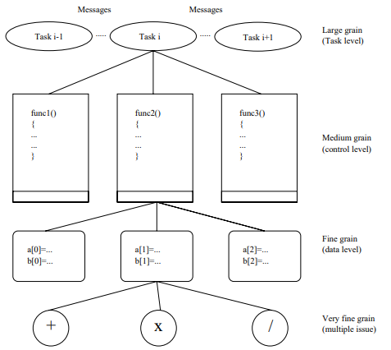
DETECTING PARALLELISM

Slide 6
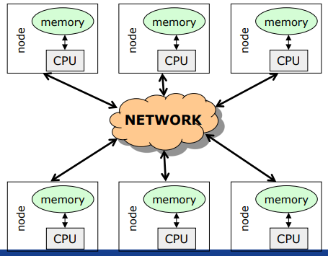
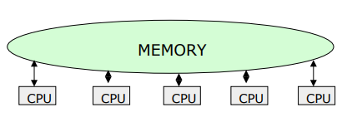
Introduction
A system is said to be parallel if it can support two or more actions executing simultaneously i.e., multiple actions are simultaneously executed in parallel systems.
The evolution of parallel processing, even if slow, gave rise to a considerable variety of programming paradigms.
Parallelism Types:
Explicit Parallelism
Implicit Parallelism
Message Passing Architecture
Shared memory Architecture

Slide 7
Explicit parallelism
Explicit Parallelism is characterized by the presence of explicit constructs in the programming language, aimed at describing (to a certain degree of detail) the way in which the parallel computation will take place.
A wide range of solutions exists within this framework. One extreme is represented by the ``ancient'' use of basic, low level mechanisms to deal with parallelism--like fork/join primitives, semaphores, etc--eventually added to existing programming languages. Although this allows the highest degree of flexibility (any form of parallel control can be implemented in terms of the basic low level primitives gif), it leaves the additional layer of complexity completely on the shoulders of the programmer, making his task extremely complicate.

Slide 8
Implicit Parallelism
Allows programmers to write their programs without any concern about the exploitation of parallelism. Exploitation of parallelism is instead automatically performed by the compiler and/or the runtime system. In this way the parallelism is transparent to the programmer maintaining the complexity of software development at the same level of standard sequential programming.
Extracting parallelism implicitly is not an easy task. For imperative programming languages, the complexity of the problem is almost prohibitively and allows positive results only for restricted sets of applications (e.g., applications which perform intensive operations on arrays.
Declarative Programming languages, and in particular Functional and Logic languages, are characterized by a very high level of abstraction, allowing the programmer to focus on what the problem is and leaving implicit many details of how the problem should be solved.
Declarative languages have opened new doors to automatic exploitation of parallelism. Their focusing on a high level description of the problem and their mathematical nature turned into positive properties for implicit exploitation of parallelism.

Slide 9
Methods for parallelism
There are many methods of programming parallel computers. Two of the most common are message passing and data parallel.
Message Passing - the user makes calls to libraries to explicitly share information between processors.
Data Parallel - data partitioning determines parallelism
Shared Memory - multiple processes sharing common memory space
Remote Memory Operation - set of processes in which a process can access the memory of another process without its participation
Threads - a single process having multiple (concurrent) execution paths
Combined Models - composed of two or more of the above.

Slide 10
Methods for parallelism
Message Passing:
Each Processor has direct access only to its local memory
Processors are connected via high-speed interconnect
Data exchange is done via explicit processor-to-processor communication i.e processes communicate by sending and receiving messages : send/receive messages
Data transfer requires cooperative operations to be performed by each process (a send operation must have matching receive)
Data Parallel:
Each process works on a different part of the same data structure
Processors have direct access to global memory and I/O through bus or fast switching network
Each processor also has its own memory (cache)
Data structures are shared in global address space
Concurrent access to shared memory must be coordinate
All message passing is done invisibly to the programmer

Slide 11
Steps in Parallelism
Independently from the specific paradigm considered, in order to execute a program which exploits parallelism, the programming language must supply the means to:
Identify parallelism, by recognizing the components of the program execution that will be (potentially) performed by different processors;
Start and stop parallel executions;
Coordinate the parallel executions (e.g., specify and implement interactions between concurrent components).

Slide 12
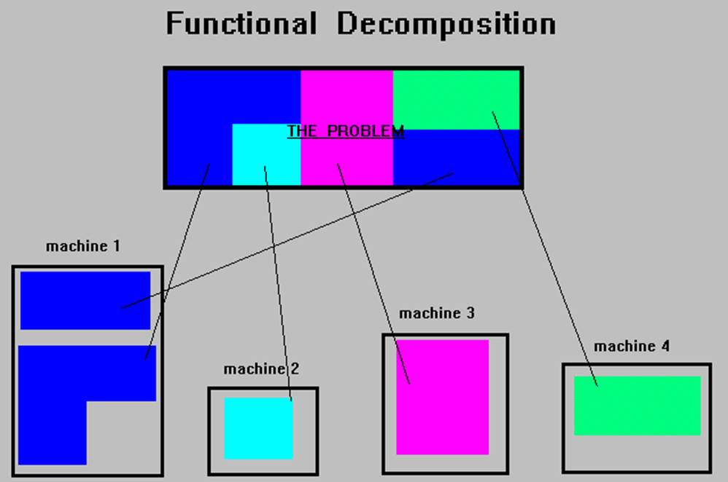
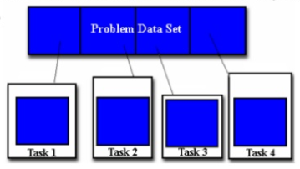
Ways for Parallelism
Functional Decomposition (Functional Parallelism)
Decomposing the problem into different tasks which can be distributed to multiple processors for simultaneous execution
Good to use when there is not static structure or fixed determination of number of calculations to be performed
Domain Decomposition (Data Parallelism)
Partitioning the problem's data domain and distributing portions to multiple processors for simultaneous execution
Good to use for problems where:
data is static (factoring and solving large matrix or finite difference calculations)
dynamic data structure tied to single entity where entity can be subsetted (large multi-body problems)
domain is fixed but computation within various regions of the domain is dynamic (fluid vortices models)

Slide 13
Parallel Programming Paradigm
Phase parallel
Divide and conquer
Pipeline
Process farm
Work pool
Note:
The parallel program consists of number of super steps, and each super step has two phases : computation phase and interaction phase

Slide 14
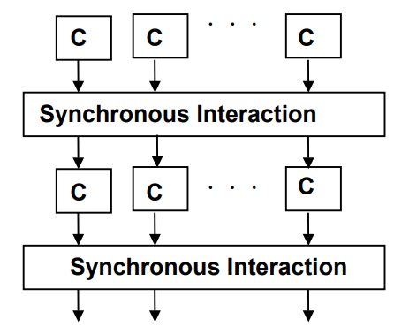
Phase Parallel Model
The phase-parallel model offers a paradigm that is widely used in parallel programming.
The parallel program consists of a number of supersteps, and each has two phases.
In a computation phase, multiple processes each perform an independent computation C.
In the subsequent interaction phase, the processes perform one or more synchronous interaction operations, such as a barrier or a blocking communication.
Then next superstep is executed.

Slide 15
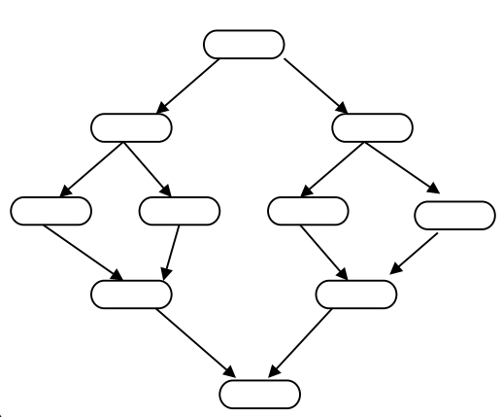
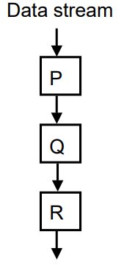
Divide and Conquer & Pipeline model
A parent process divides its workload into several smaller pieces and assigns them to a number of child processes.
The child processes then compute their workload in parallel and the results are merged by the parent.
The dividing and the merging procedures are done recursively.
This paradigm is very natural for computations such as quick sort.
Pipeline
In pipeline paradigm, a number of processes form a virtual pipeline.
A continuous data stream is fed into the pipeline, and the processes execute at different pipeline stages simultaneously in an overlapped fashion.

Slide 16
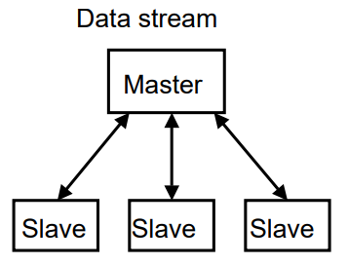
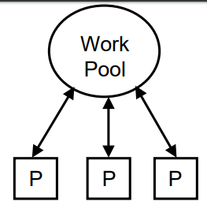
Process Farm & Work Pool Model
This paradigm is also known as the master-slave paradigm.
A master process executes the essentially sequential part of the parallel program and spawns a number of slave processes to execute the parallel workload.
When a slave finishes its workload, it informs the master which assigns a new workload to the slave.
This is a very simple paradigm, where the coordination is done by the master.
This paradigm is often used in a shared variable model.
A pool of works is realized in a global data structure.
A number of processes are created. Initially, there may be just one piece of work in the pool.
Any free process fetches a piece of work from the pool and executes it, producing zero, one, or more new work pieces put into the pool. The parallel program ends when the work pool becomes empty.
This paradigm facilitates load balancing, as the workload is dynamically allocated to free processes.

Slide 17
Parallel Program using Python
A thread is basically an independent flow of execution. A single process can consist of multiple threads. Each thread in a program performs a particular task. For Example, when you are playing a game say FIFA on your PC, the game as a whole is a single process, but it consists of several threads responsible for playing the music, taking input from the user, running the opponent synchronously, etc.
Threading is that it allows a user to run different parts of the program in a concurrent manner and make the design of the program simpler.
Multithreading in Python can be achieved by importing the threading module.
Example:
import threading
from threading import *

Slide 18
Parallel program using Threads in Python
# simplest way to use a Thread is to instantiate it with a target function and call start() to let it begin working.
from threading import Thread,current_thread
print(current_thread().getName())
def mt():
print("Child Thread")
for i in range(11,20):
print(i*2)
def disp():
for i in range(10):
print(i*2)
child=Thread(target=mt)
child.start()
disp()
print("Executing thread name :",current_thread().getName())
from threading import Thread,current_thread
class mythread(Thread):
def run(self):
for x in range(7):
print("Hi from child")
a = mythread()
a.start()
a.join()
print("Bye from",current_thread().getName())

Slide 19
Parallel program using Process in Python
import multiprocessing
def worker(num):
print('Worker:', num)
for i in range(num):
print(i)
return
jobs = []
for i in range(1,5):
p = multiprocessing.Process(target=worker, args=(i+10,))
jobs.append(p)
p.start()

Slide 20
Concurrent Programming Paradigm
Computing systems model the world, and the world contains actors that execute independently of, but communicate with, each other. In modelling the world, many (possibly) parallel executions have to be composed and coordinated, and that's where the study of concurrency comes in.
There are two common models for concurrent programming: shared memory and message passing.
Shared memory. In the shared memory model of concurrency, concurrent modules interact by reading and writing shared objects in memory.
Message passing. In the message-passing model, concurrent modules interact by sending messages to each other through a communication channel. Modules send off messages, and incoming messages to each module are queued up for handling

Slide 21
Issues Concurrent Programming Paradigm
Concurrent programming is programming with multiple tasks. The major issues of concurrent programming are:
Sharing computational resources between the tasks;
Interaction of the tasks.
Objects shared by multiple tasks have to be safe for concurrent access. Such objects are called protected. Tasks accessing such an object interact with each other indirectly through the object.
An access to the protected object can be:
Lock-free, when the task accessing the object is not blocked for a considerable time;
Blocking, otherwise.
Blocking objects can be used for task synchronization. To the examples of such objects belong:
Events;
Mutexes and semaphores;
Waitable timers;
Queues

Slide 22
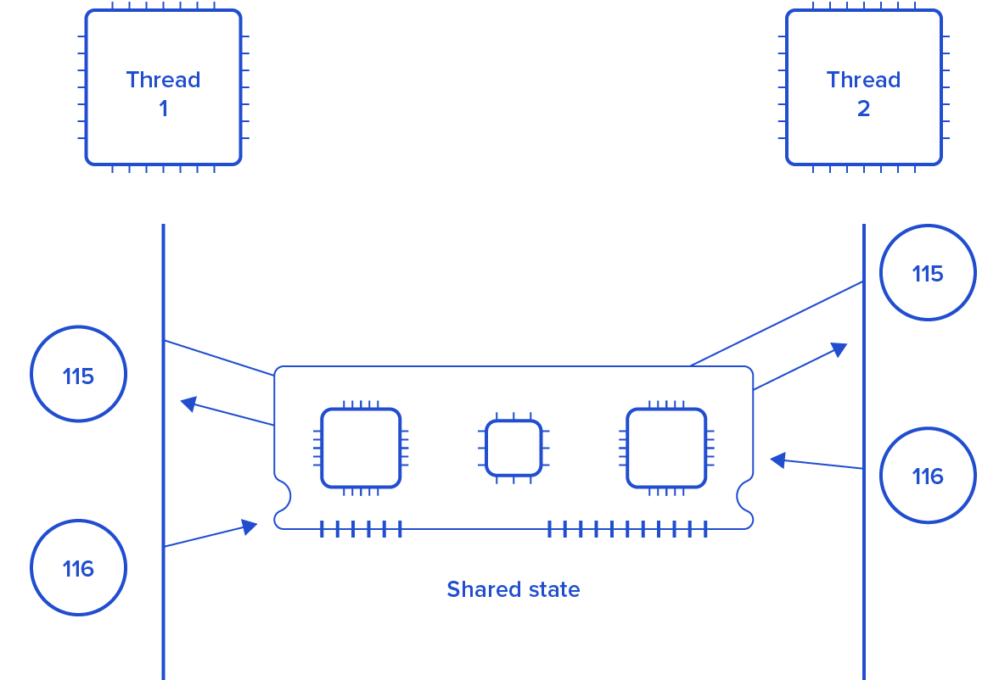
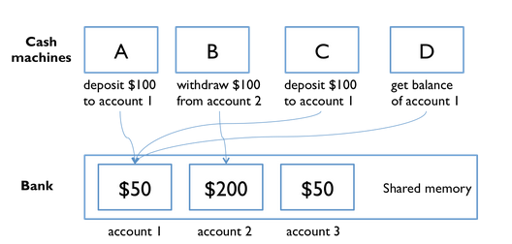
Issues Concurrent Programming Paradigm

Slide 23
Race Condition
import threading
x = 0 # A shared value
COUNT = 100
def incr():
global x
for i in range(COUNT):
x += 1
print(x)
def decr():
global x
for i in range(COUNT):
x -= 1
print(x)
t1 = threading.Thread(target=incr)
t2 = threading.Thread(target=decr)
t1.start()
t2.start()
t1.join()
t2.join()
print(x)

Slide 24
Synchronization in Python
Locks:
Locks are perhaps the simplest synchronization primitives in Python. A Lock has only two states — locked and unlocked (surprise). It is created in the unlocked state and has two principal methods — acquire() and release(). The acquire() method locks the Lock and blocks execution until the release() method in some other co-routine sets it to unlocked.
R-Locks:
R-Lock class is a version of simple locking that only blocks if the lock is held by another thread. While simple locks will block if the same thread attempts to acquire the same lock twice, a re-entrant lock only blocks if another thread currently holds the lock.
Semaphore:
A semaphore has an internal counter rather than a lock flag, and it only blocks if more than a given number of threads have attempted to hold the semaphore. Depending on how the semaphore is initialized, this allows multiple threads to access the same code section simultaneously.

Slide 25
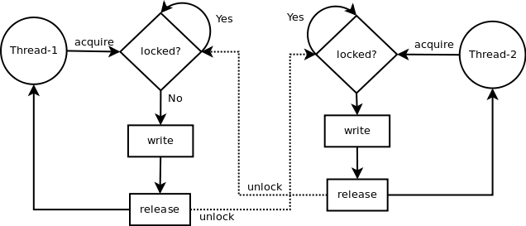
LOCK in python
Synchronization using LOCK
Locks have 2 states: locked and unlocked. 2 methods are used to manipulate them: acquire() and release(). Those are the rules:
if the state is unlocked: a call to acquire() changes the state to locked.
if the state is locked: a call to acquire() blocks until another thread calls release().
if the state is unlocked: a call to release() raises a RuntimeError exception.
if the state is locked: a call to release() changes the state to unlocked().

Slide 26
Synchronization in Python using Lock
import threading
x = 0 # A shared value
COUNT = 100
lock = threading.Lock()
def incr():
global x
lock.acquire()
print("thread locked for increment cur x=",x)
for i in range(COUNT):
x += 1
print(x)
lock.release()
print("thread release from increment cur x=",x)
def decr():
global x
lock.acquire()
print("thread locked for decrement cur x=",x)
for i in range(COUNT):
x -= 1
print(x)
lock.release()
print("thread release from decrement cur x=",x)
t1 = threading.Thread(target=incr)
t2 = threading.Thread(target=decr)
t1.start()
t2.start()
t1.join()
t2.join()

Slide 27
Synchronization in Python using RLock
import threading
class Foo(object):
lock = threading.RLock()
def __init__(self):
self.x = 0
def add(self,n):
with Foo.lock:
self.x += n
def incr(self):
with Foo.lock:
self.add(1)
def decr(self):
with Foo.lock:
self.add(-1)
def adder(f,count):
while count > 0:
f.incr()
count -= 1
def subber(f,count):
while count > 0:
f.decr()
count -= 1
# Create some threads and make sure it works
COUNT = 10
f = Foo()
t1 = threading.Thread(target=adder,args=(f,COUNT))
t2 = threading.Thread(target=subber,args=(f,COUNT))
t1.start()
t2.start()
t1.join()
t2.join()
print(f.x)

Slide 28
Synchronization in Python using Semaphore
import threading
import time
done = threading.Semaphore(0)
item = None
def producer():
global item
print "I'm the producer and I produce data."
print "Producer is going to sleep."
time.sleep(10)
item = "Hello"
print "Producer is alive. Signaling the consumer."
done.release()
def consumer():
print "I'm a consumer and I wait for data."
print "Consumer is waiting."
done.acquire()
print "Consumer got", item
t1 = threading.Thread(target=producer)
t2 = threading.Thread(target=consumer)
t1.start()
t2.start()

Slide 29
Synchronization in Python using event
import threading
import time
item = None
# A semaphore to indicate that an item is available
available = threading.Semaphore(0)
# An event to indicate that processing is complete
completed = threading.Event()
# A worker thread
def worker():
while True:
available.acquire()
print "worker: processing", item
time.sleep(5)
print "worker: done"
completed.set()
# A producer thread
def producer():
global item
for x in range(5):
completed.clear() # Clear the event
item = x # Set the item
print "producer: produced an item"
available.release() # Signal on the semaphore
completed.wait()
print "producer: item was processed"
t1 = threading.Thread(target=producer)
t1.start()
t2 = threading.Thread(target=worker)
t2.setDaemon(True)
t2.start()

Slide 30
Producer and Consumer problem using thread
import threading,time,Queue
items = Queue.Queue()
# A producer thread
def producer():
print "I'm the producer"
for i in range(30):
items.put(i)
time.sleep(1)
# A consumer thread
def consumer():
print "I'm a consumer", threading.currentThread().name
while True:
x = items.get()
print threading.currentThread().name,"got", x
time.sleep(5)
# Launch a bunch of consumers
cons = [threading.Thread(target=consumer)
for i in range(10)]
for c in cons:
c.setDaemon(True)
c.start()
# Run the producer
producer()

Slide 31
Producer and Consumer problem using thread
import threading
import time
# A list of items that are being produced. Note: it is actually
# more efficient to use a collections.deque() object for this.
items = []
# A condition variable for items
items_cv = threading.Condition()
def producer():
print "I'm the producer"
for i in range(30):
with items_cv: # Always must acquire the lock first
items.append(i) # Add an item to the list
items_cv.notify() # Send a notification signal
time.sleep(1)
def consumer():
print "I'm a consumer", threading.currentThread().name
while True:
with items_cv: # Must always acquire the lock
while not items: # Check if there are any items
items_cv.wait() # If not, we have to sleep
x = items.pop(0) # Pop an item off
print threading.currentThread().name,"got", x
time.sleep(5)
cons = [threading.Thread(target=consumer)
for i in range(10)]
for c in cons:
c.setDaemon(True)
c.start()
producer()

